Slide 1
Evaluating the Usefulness and Effectiveness of a Visualization for a Field of Study Hierarchy Graph to Explore NLP Research
01.07.2024, Master’s Thesis Final
Patrick Kufner

Slide 2
Outline
Target User – Persona
Motivation
Research Questions
Methodology
Results
Conclusion & Future Work

Slide 3

1. Target User – Persona
Goals
Write Bachelor’s Thesis
Achieve Bachelor’s Degree
Gain Knowledge in NLP Domain
Name: Anna Mayer
Age: 23
Work: Informatics Student
University: TUM
Setting
Anna has followed the curriculum of TUMs Bachelor of Science Informatics degree. She has finished all the subjects and only needs to write her Bachelor’s Thesis. She found a topic within the NLP domain and must start her thesis with a literature review.
Frustrations
Limited NLP specific knowledge – doesn’t know keywords yet
Lacking research skills – haven’t had to scientifically research yet

Slide 4
2. Motivation
New in a domain → Missing domain-specific knowledge ^{[1] [2] [4]}
Information overload
Unclear where to start and where to go next ^{[6]}
Generate overview ^{[3]}
Visual information seeking mantra: “Overview first, zoom and filter, then details-on-demand” ^{[7]}
Enable exploratory search via graph representation ^{[4] [5]}
Problem
Approach
Proposed Solution
Notes:
- Information overload: searching for NLP on google scholar results in over 1,5 Million results

Slide 5
3. Research Questions
What are the contemporary trends and advancements in graph-based exploratory search approaches?
How can the graph view be optimized to suit the distinctive characteristics of NLP research papers?
What insights can be gleaned from a user study comparing the effectiveness and usefulness of graph view and lookup search in NLP paper discovery?
What methods are effective for evaluating exploratory search through a hierarchical graph visualization approach?

Slide 6
4. Methodology – RQ1: Complementary Trends
RecVis ^{[11]}
Recommendation system for scientific literature
Upload seed document to find similar literature
ARGO SCHOLAR ^{[12]}
Web-based visualization tool
Interactive exploration
Sharing of results
Connected Papers ^{[13]}
Find similar papers to searched one
Based on concepts of Co-citation and Bibliographic Coupling

Slide 7
4. Methodology – RQ1: Complementary Trends
RecVis ^{[11]}
ARGO SCHOLAR ^{[12]}
Connected Papers ^{[13]}
Their Goals
Search initial publication
Find similar publications
Visualize similarity
Our Goals
Visualize domain
Navigate research fields
Generate overview

Slide 8
4. Methodology – RQ1: Groundwork
Thinkbase ^{[14]}
Navigate Freebase on a graph interface
Thinkpedia ^{[14]}
Unstructured Graph
Navigate Wikipedia on a graph interface
Unstructured Graph
Issues:
Unintuitive to start
Disorientation through large amount of data & unstructured graphs

Slide 9
4. Methodology – RQ2: Methods
How to evaluate exploratory search?
Performance based evaluation methods
Task time
Number of successful findings
Correct answers
Precision, Recall, F1 Score
Informal evaluation approach
User is given an open-ended task
User must report on findings
Questionnaires to rate experience
Compare Questionnaire Results

Slide 10
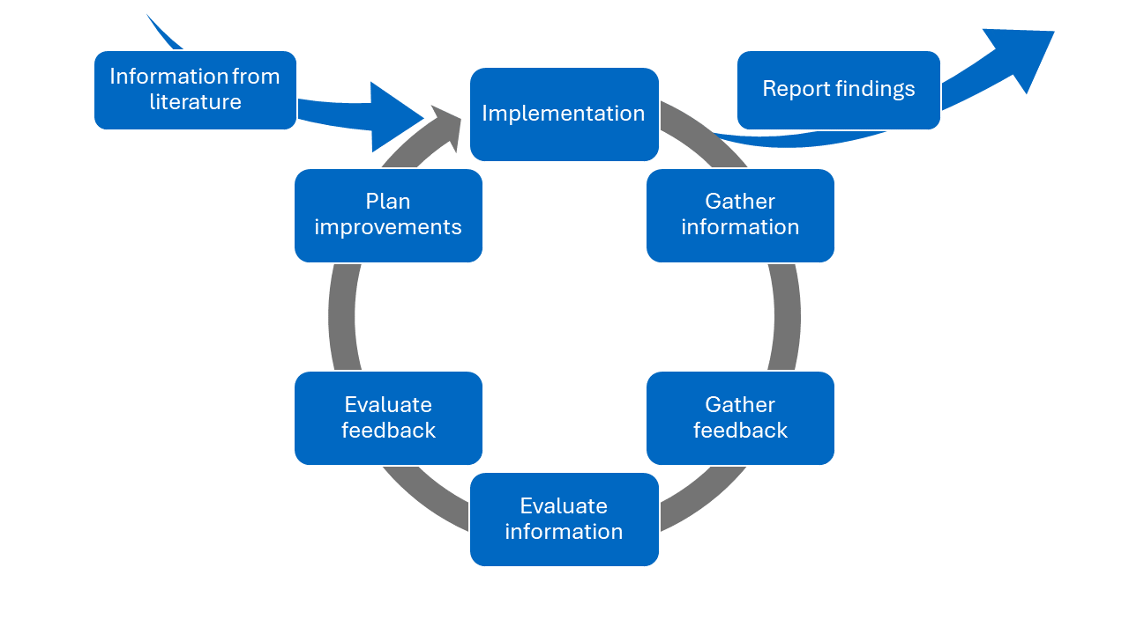
4. Methodology – RQ3: Graph optimization process (User Study)
Optimization Process of the hierarchy graph
Two iterations of user study
  Research assistants as participants
  → High quality feedback from experienced researchers
  Friends, fellow students & co-workers as participants
  → Additional suggestions from low domain knowledge researchers
Iterative process
  Gather information
  Evaluate information
  Implement information
  Report findings

Slide 11
4. Methodology – RQ3: Graph optimization process (User Study)
Existing Project
Part of NLP-KG Research Project
Data provided in Neo4j Database
Pre-existing Web App from previous Bachelor’s Thesis
Search using Search bar
Hierarchy Graph prototype
Provided by Tim’s taxonomy

Slide 12
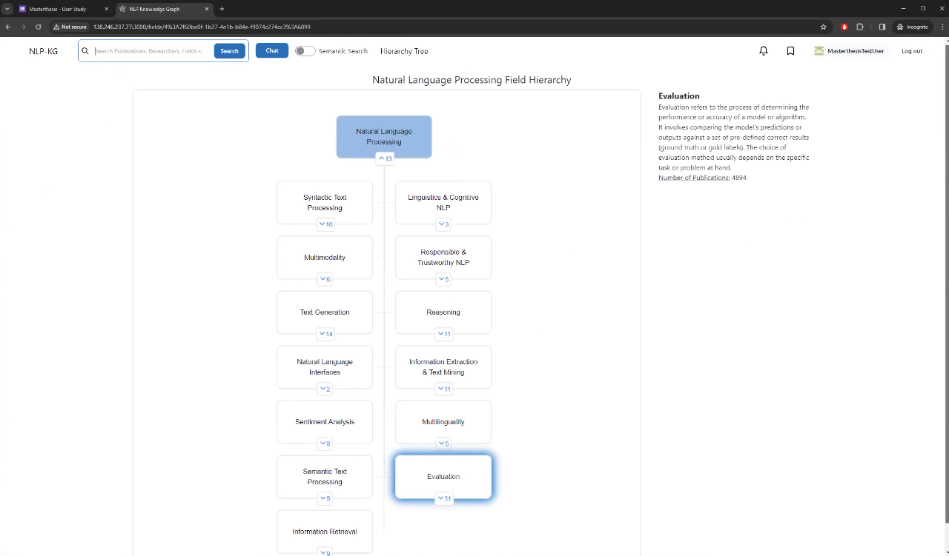
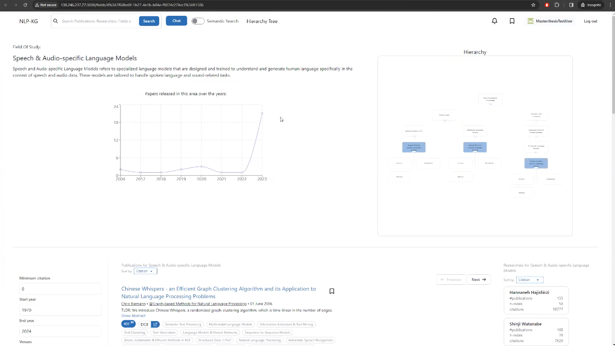
4. Methodology – RQ3: Graph optimization process (User Study)
Existing Project

Slide 13
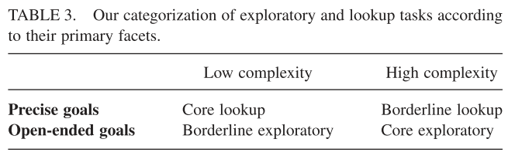
4. Methodology – User Study Round 1
Overview
Scenarios taken from Literature
Distinguish between “borderline” and “core” exploration ^{[8]}
Topics A and B extracted from hierarchy graph
  Same level within the hierarchy graph
  Roughly same amount of child nodes
Changed Name of Topics
  Simulate exploration of unclear definition
  No unfair advantage
2 Versions with switched Scenario Topic allocation
Topic A: Ethical NLP
Topic B: Speech & Audio in NLP
^{[8]}

Slide 14
4. Methodology – User Study Round 1
Scenarios
Knowledge acquisition
“You are going to start a new research project on the topic [Righteous (correct, proper, decent, morally right) usage of NLP]. You would like to learn as much information as possible about this topic, e.g. applications, problems, specific algorithms.” ^{[8]}
Planning
“You are going to give a talk on the topic [Voice & Sound in NLP]. Plan the structure of your presentation, including short titles of the headings of your slides and using bullet points to describe the content.” ^{[8]}

Slide 15



4. Methodology – User Study Round 1
Visualization
1. Knowledge Acquisition (Hierarchy Graph)
1. Knowledge Acquisition (Search bar)
2. Planning (Search bar)
2. Planning (Hierarchy Graph)
Report Findings

Slide 16
4. Methodology – User Study Round 1
Questionnaires
SUS Questionnaire
  Taken from Literature
  Evaluate Hierarchy Graph to Benchmark
Personal Evaluation Questionnaire
  Come up ourself
  Compare Hierarchy Graph to Search bar
Open Feedback
  Mix from Literature and own statements
  Get suggestions on how to improve the hierarchy graph
Personal Evaluation Questionnaire
(Version for hierarchy graph & search bar)
I had a great experience using the hierarchy graph/search bar
I was able to make new discoveries
The hierarchy graph/search bar helped me to make unexpended but relevant discoveries
I found interesting information
The user interface of the hierarchy graph/search bar was easy to navigate
The user interface of the hierarchy graph/search bar was visually appealing
I am satisfied with the information I found using the hierarchy graph/search bar

Slide 17
5. Results – User Study Round 1
6 Research assistants from sebis chair participated live via Zoom meetings
Alternately assigned version A or B (order of Hierarchy Graph and Search bar is changed)
Research time limited to 15 min
Average SUS Score: 89.583 (range: 0-100)
Average Personal Evaluation (Hierarchy Graph): 4,357 (range: 1-5)
Average Personal Evaluation (Search bar): 4,400 (range: 1-5)
Open Feedback – Main improvements requests:
  Show all siblings when on a fields page
  Hide duplicate navigational ways on a fields page
  “Reset view option” missing (also expand and collapse all option)
  Search within the hierarchy graph
  “No colors” within the hierarchy graph
  Marker to show current place in hierarchy graph

Slide 18
5. Results – User Study Round 1
Positive aspects:
  Easy navigation thanks to “clear to follow [...] hierarchy”
  “Easy to get started with a new research field”
  It “helps to find unexpected results”
  “Overview you get from using this view” makes it “easy to find related fields which might not have been considered otherwise”
When to use the Hierarchy Graph:
  Get an overview
  Make serendipitous discoveries
  Stuck with keyword search
  “Delve deep in some topics”

Slide 19
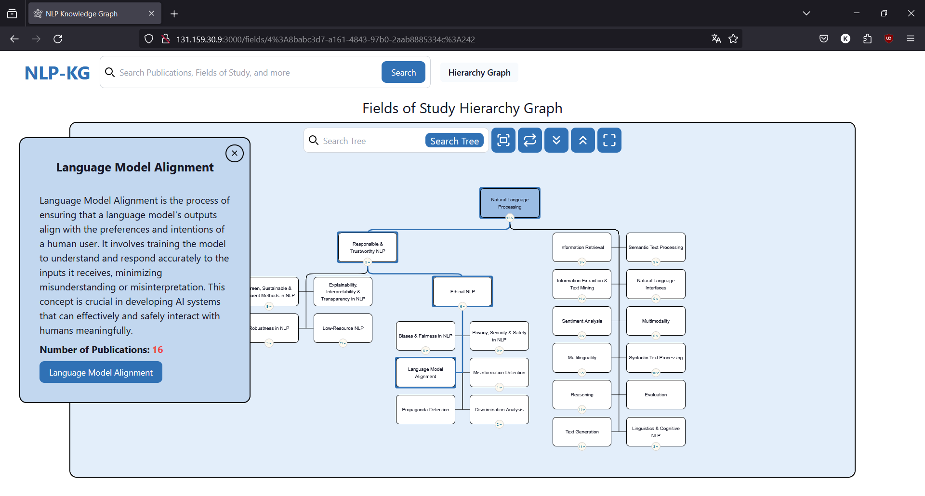
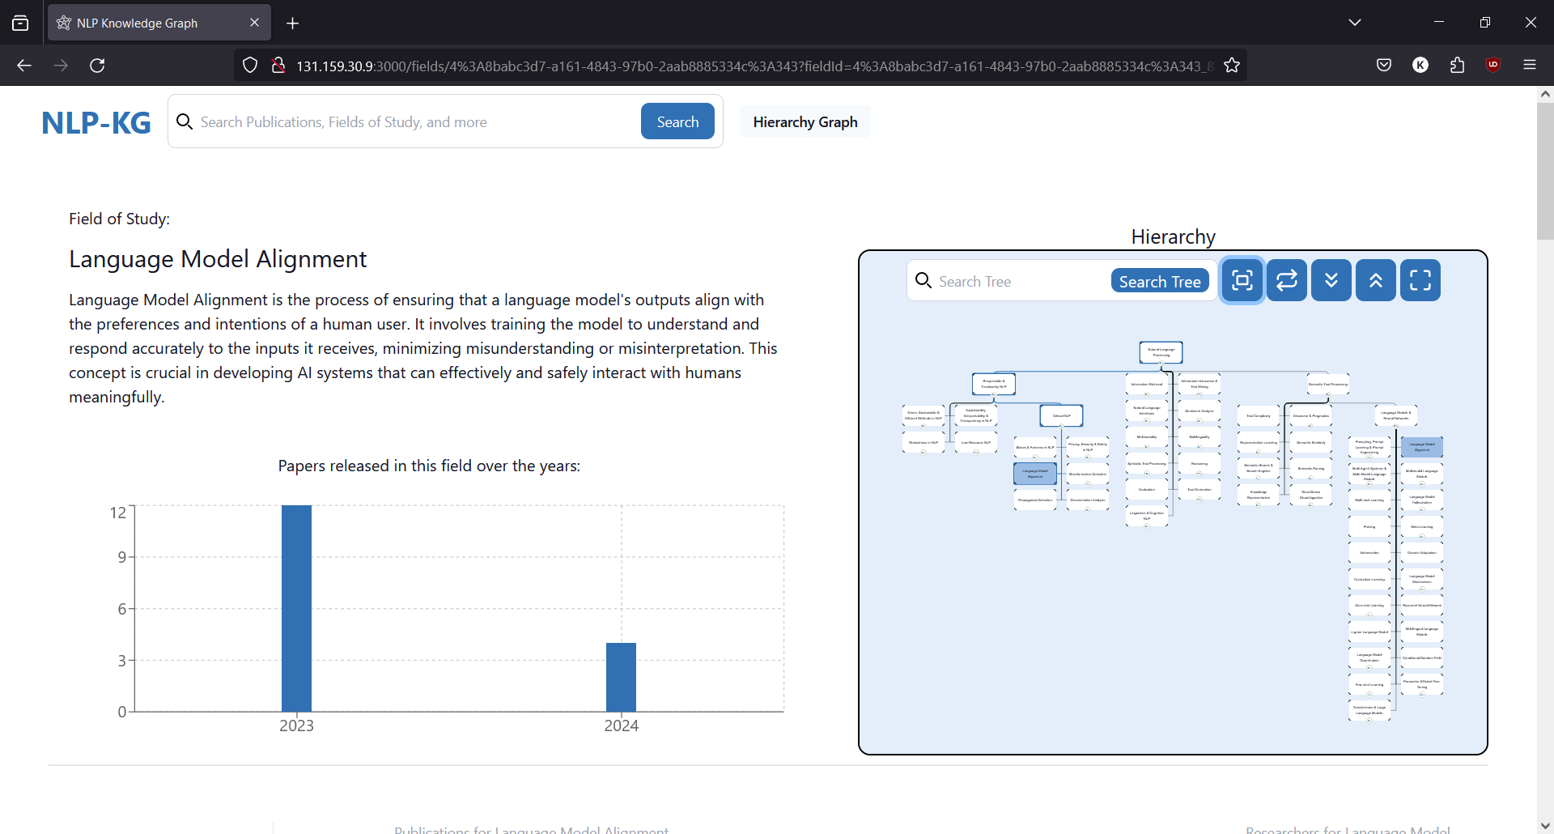
5. Results – User Study Round 1

Slide 20
4. Methodology – User Study Round 2
Changed Structure
Focus on knowledge acquisition task (based on feedback from round 1)
No more separation of hierarchy graph and search bar (based on feedback from round 1)
Not exclusively recorded meetings → participants could participate on their own
No more time limit
→ participants should search until they feel accomplished
Clarification of some questionnaire statements
Added of some statements to the open feedback

Slide 21
5. Results – User Study Round 2
16 friends, fellow students and colleagues participated – 10 are recorded
Alternately assigned version A or B (Ethical NLP or Speech & Audio in NLP )
Research time no longer limited
Average SUS Score: 83,125 (range: 0-100)
Average Personal Evaluation (Hierarchy Graph): 4,206 (range: 1-5)
Average Personal Evaluation (Search bar): 3,715 (range: 1-5)
Open Feedback – Main improvements requests:
  Improve search for hierarchy graph
    Hide irrelevant nodes when searching
    Hide complete tree if no matches
  Enable sorting for nodes
  Visualize number of publications within the hierarchy graph
  Show field’s trend within node
  Server stability

Slide 22
5. Results – User Study Round 2
Positive aspects:
  Easy and intuitive to use
  Enables an overview
  Enables a quick start into a new topic
  Helps to understand relationships between fields
  Complements the search bar
When to use the Hierarchy Graph:
  Get an overview or a “grander picture”
  Missing knowledge about domain specific keywords
  Unclear end-goal (unsure which information is needed)
When not to use the Hierarchy Graph:
  Looking for specific information
  Decent domain specific knowledge

Slide 23
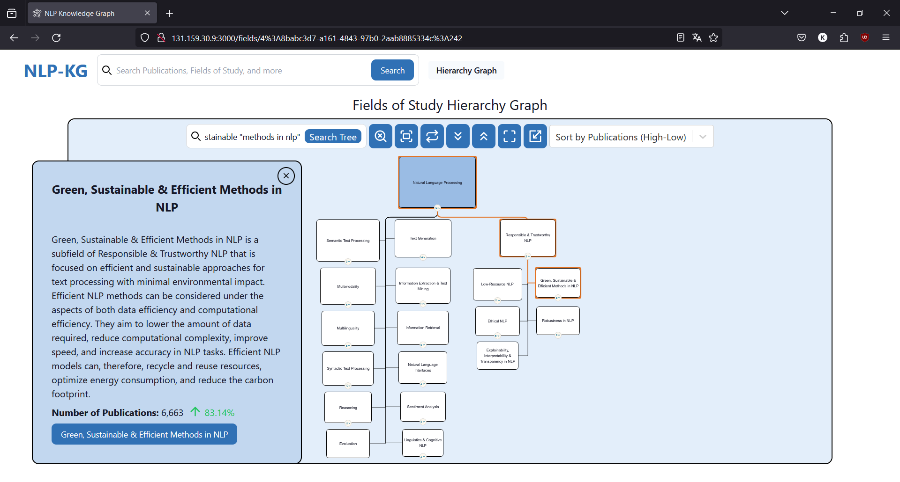
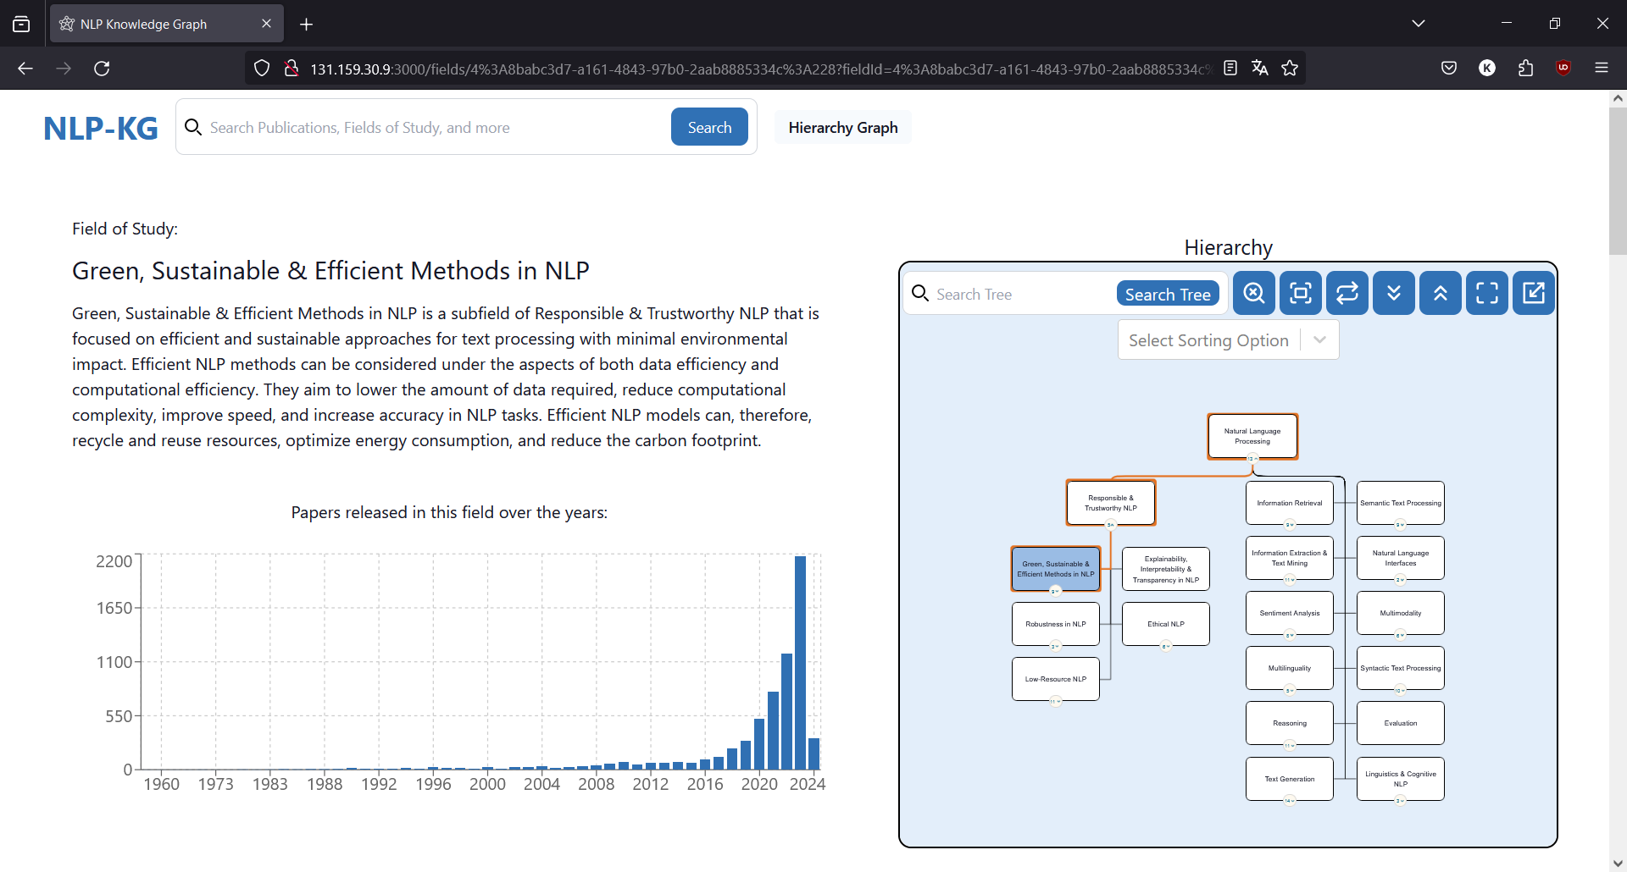
5. Results – User Study Round 2

Slide 24
6. Conclusion & Future Work
Conclusion
Hierarchy Graph is not a replacement for the Search bar
Hierarchy Graph enriches search capabilities as a feature
Seek new inspiration for keywords
Gain an overview of the domain
Future Work
Generalize findings with more participants
Differentiate target users to gather personalization data
Bachelor’s students
Master’s students
Postgraduates
Professors
Private Researchers
Generalize on broader topics than NLP
Learnings
Orienteering though the hierarchy graph takes longer
Serendipitous discoveries through pre-filtering of taxonomy and sibling nodes
Hierarchy graph enables an overview

Slide 25
References
[1] Lehmann, Simon; Schwanecke, Ulrich; Dörner, Ralf (2010)
[2] Medlar, Alan; Ilves, Kalle; Wang, Ping; Buntine, Wray; Glowacka, Dorota (2016)
[3] Nazemi, Kawa; Breyer, Matthias; Forster, Jeanette; Burkhardt, Dirk; Kuijper, Arjan (2011)
[4] Nedumov, Y. R.; Kuznetsov, S. D. (2019)
[5] Palagi, Emilie; Gandon, Fabien; Giboin, Alain; Troncy, Raphaël (2017)
[6] Sarrafzadeh, Bahareh; Vechtomova, Olga; Jokic, Vlado (2014)
[7] Ben Shneiderman (1996)
[8] Athukorala, Kumaripaba; Głowacka, Dorota; Jacucci, Giulio; Oulasvirta, Antti; Vreeken, Jilles (2016)
[9] Egusa, Yuka; Saito, Hitomi; Takaku, Masao; Terai, Hitoshi; Miwa, Makiko; Kando, Noriko (2010)
[10] Athukorala, Kumaripaba; Medlar, Alan; Oulasvirta, Antti; Jacucci, Giulio; Glowacka, Dorota (2016)
[11] C. Breitinger, B. Kolcu, M. Meuschke, N. Meuschke, and B. Gipp. “Supporting the Exploration of Semantic Features in Academic Literature using Graph-based Visualizations”. In: Proceedings of the ACM/IEEE Joint Conference on Digital Libraries in 2020. JCDL ’20. Virtual Event, China: Association for Computing Machinery, 2020, pp. 377–380. isbn: 9781450375856. doi: 10.1145/3383583.3398599. url: https://doi.org/10.1145/ 3383583.3398599.
[12] K. Li, H. Yang, E. Montoya, A. Upadhayay, Z. Zhou, J. Saad-Falcon, and P. Chau. “Visual Exploration of Literature with Argo Scholar”. In: Oct. 2022, pp. 4912–4916. doi: 10.1145/3511808.3557177.
[13] https://www.connectedpapers.com
[14] C. Hirsch, J. Hosking, and J. Grundy. “Interactive Visualization Tools for Exploring the Semantic Graph of Large Knowledge Spaces”. In: (May 2010).

Slide 26
B.Sc.
Patrick Kufner
Master’s Student Information Systems
17132
matthes@in.tum.de

Slide 27
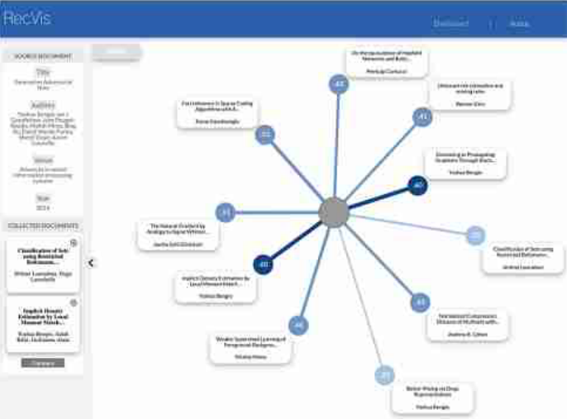
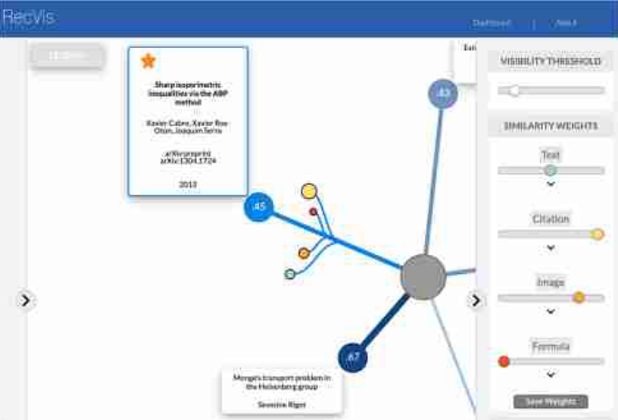
Backup: RecVis Screenshots

Slide 28
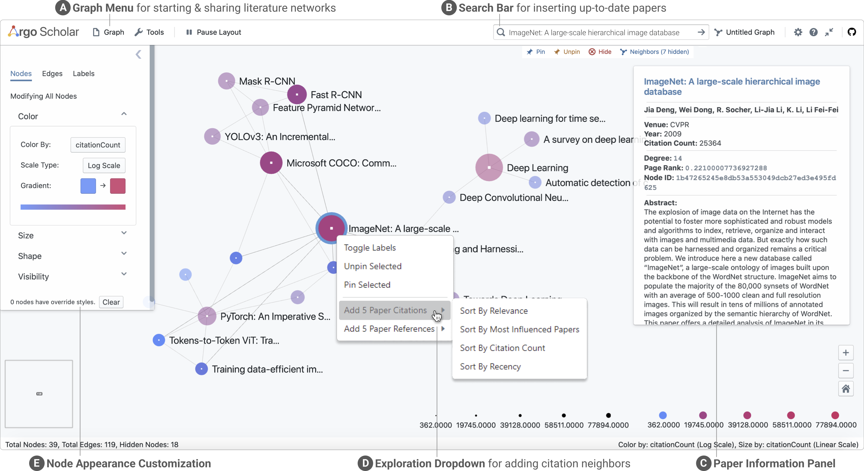
Backup: Argo Scholar Screenshot

Slide 29
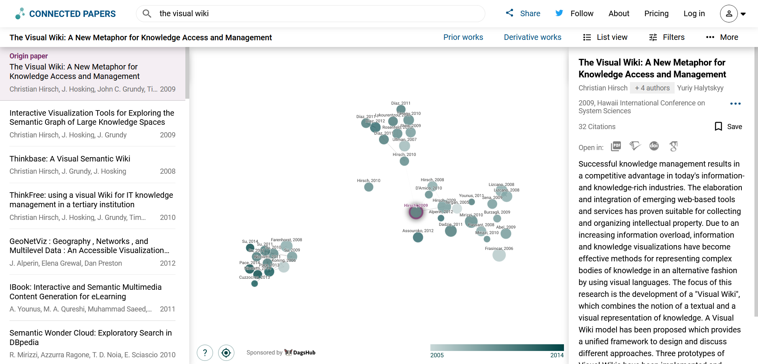
Backup: Connected Papers Screenshot

Slide 30
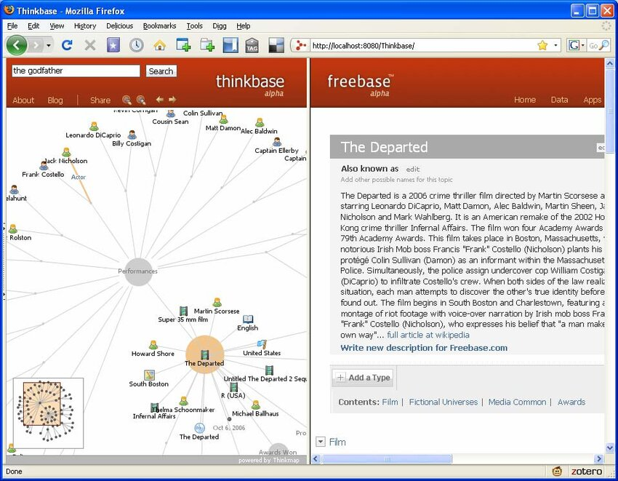
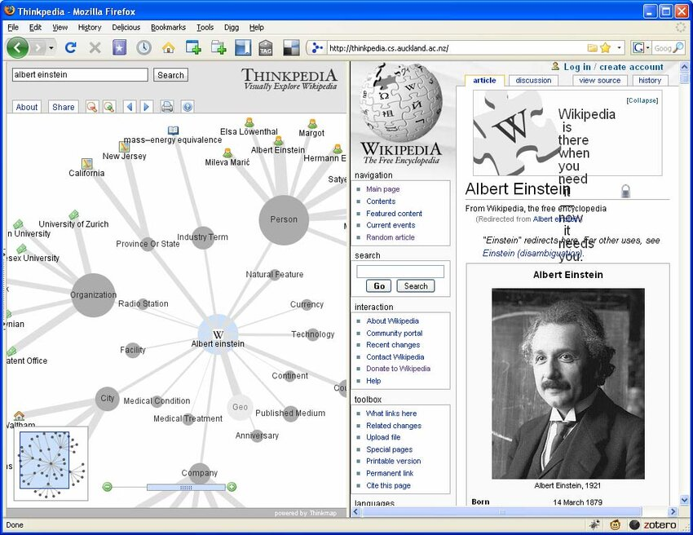
Backup: Thinkbase & Thinkpedia Screenshots
Thinkbase
Thinkpedia

Slide 31
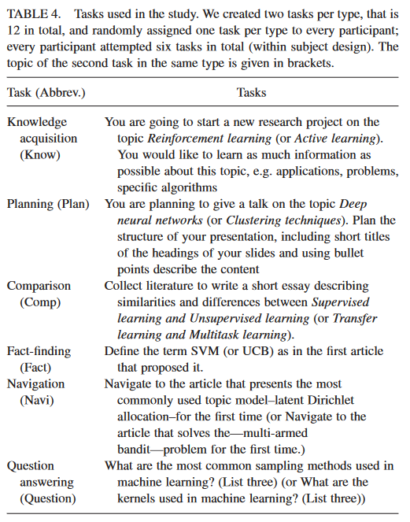
Backup: Tasks from Literature
^{[8]}

Slide 32
Backup: SUS Questionnaire
I think that I would like to use this system frequently
I found the system unnecessarily complex
I thought the system was easy to use
I think that I would need the support of a technical person to be able to use this system
I found the various functions in this system were well-integrated
I thought there was too much inconsistency in this system
I would imagine that most people would learn to use this system very quickly
I found the system very cumbersome to use
I felt very confident using the system
I needed to learn a lot of things before I could get going with this system

Slide 33
Backup: Open Feedback Round 1
List the most negative aspect(s)
List the most positive aspect(s)
When would you use the hierarchy graph?
Are there features you missed on your search?
What could be improved?
Is there anything else you would like to share?

Slide 34
Backup: Open Feedback Round 2
List the most negative aspect(s)
List the most positive aspect(s)
How useful was the hierarchy graph for you to get an overview of the topic in the scenario?
How useful was the search bar for you to get an overview of the topic in the scenario?
How useful was the hierarchy graph for you to access specific information about the topic in the scenario?
How useful was the search bar for you to access specific information about the topic in the scenario?
In what scenario do you find the hierarchy graph more advantageous compared to the search bar?
In what scenario do you find the search bar more advantageous compared to the hierarchy graph?
Do you believe there was significant information that you might have overlooked?
If you answered the previous question with yes: Which information, do you believe you might have overlooked (e.g., you missed datasets, models, certain approaches, …)?
Other than the most negative aspects, did you miss any features in our system on your search?
Other than the most negative aspects, what could be improved in our system?
Is there anything else you would like to share?

